Slide 1
WEB PROGRAMMING Assignment 1
Name: Shukirillaev Mukhammad Sodik Sherzodbek Ugli
Major: Computer Engineering
Student Number: 202438379
Name: Akhmedov Yusufjon Muhammad ugli
Major: Computer Engineering
Student Number: 202438404
Due date: 2025.03.21
Submission date: 2025.03.21

Slide 2
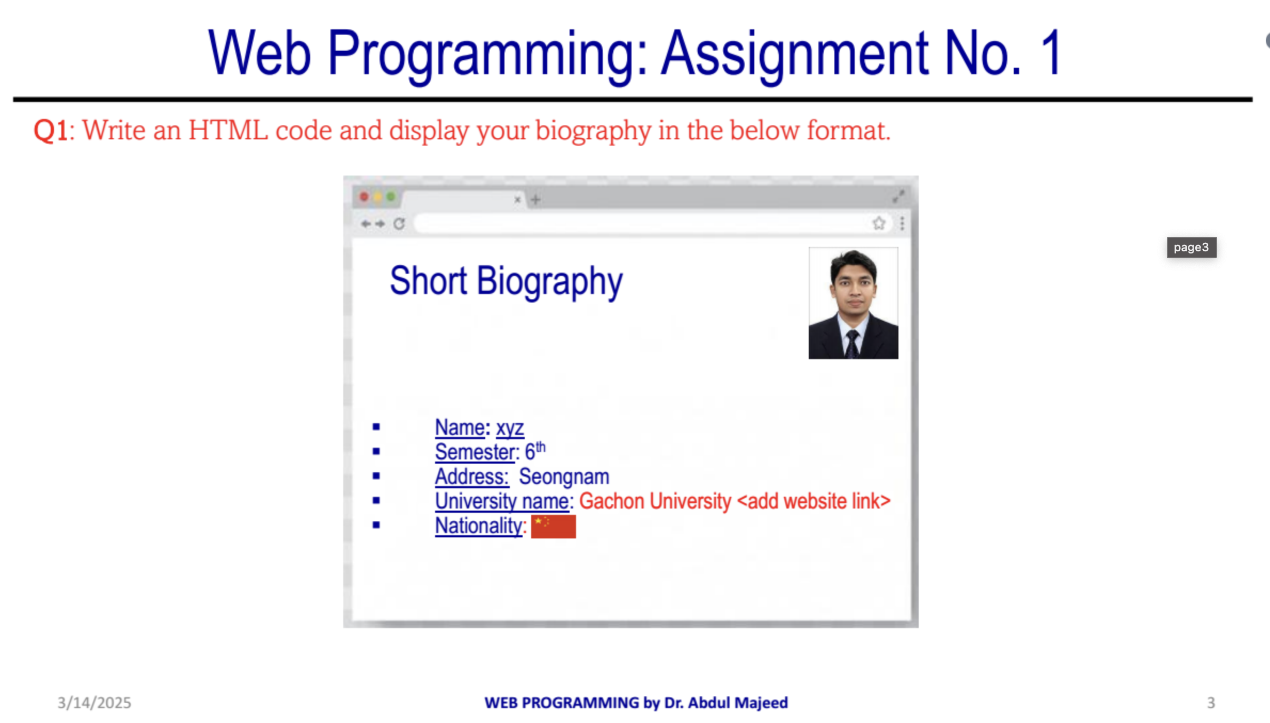
TASK 1 SHORT BIO PAGE

Slide 3
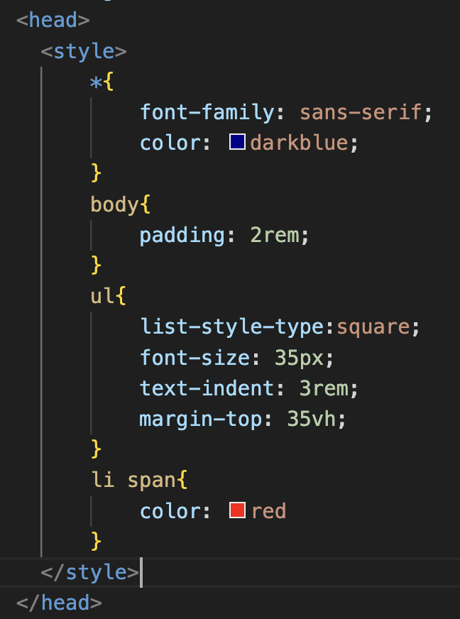
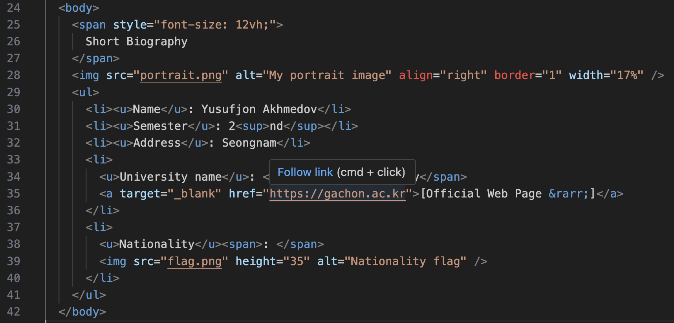
TASK 1 HTML ELEMENTS & STYLES

Slide 4
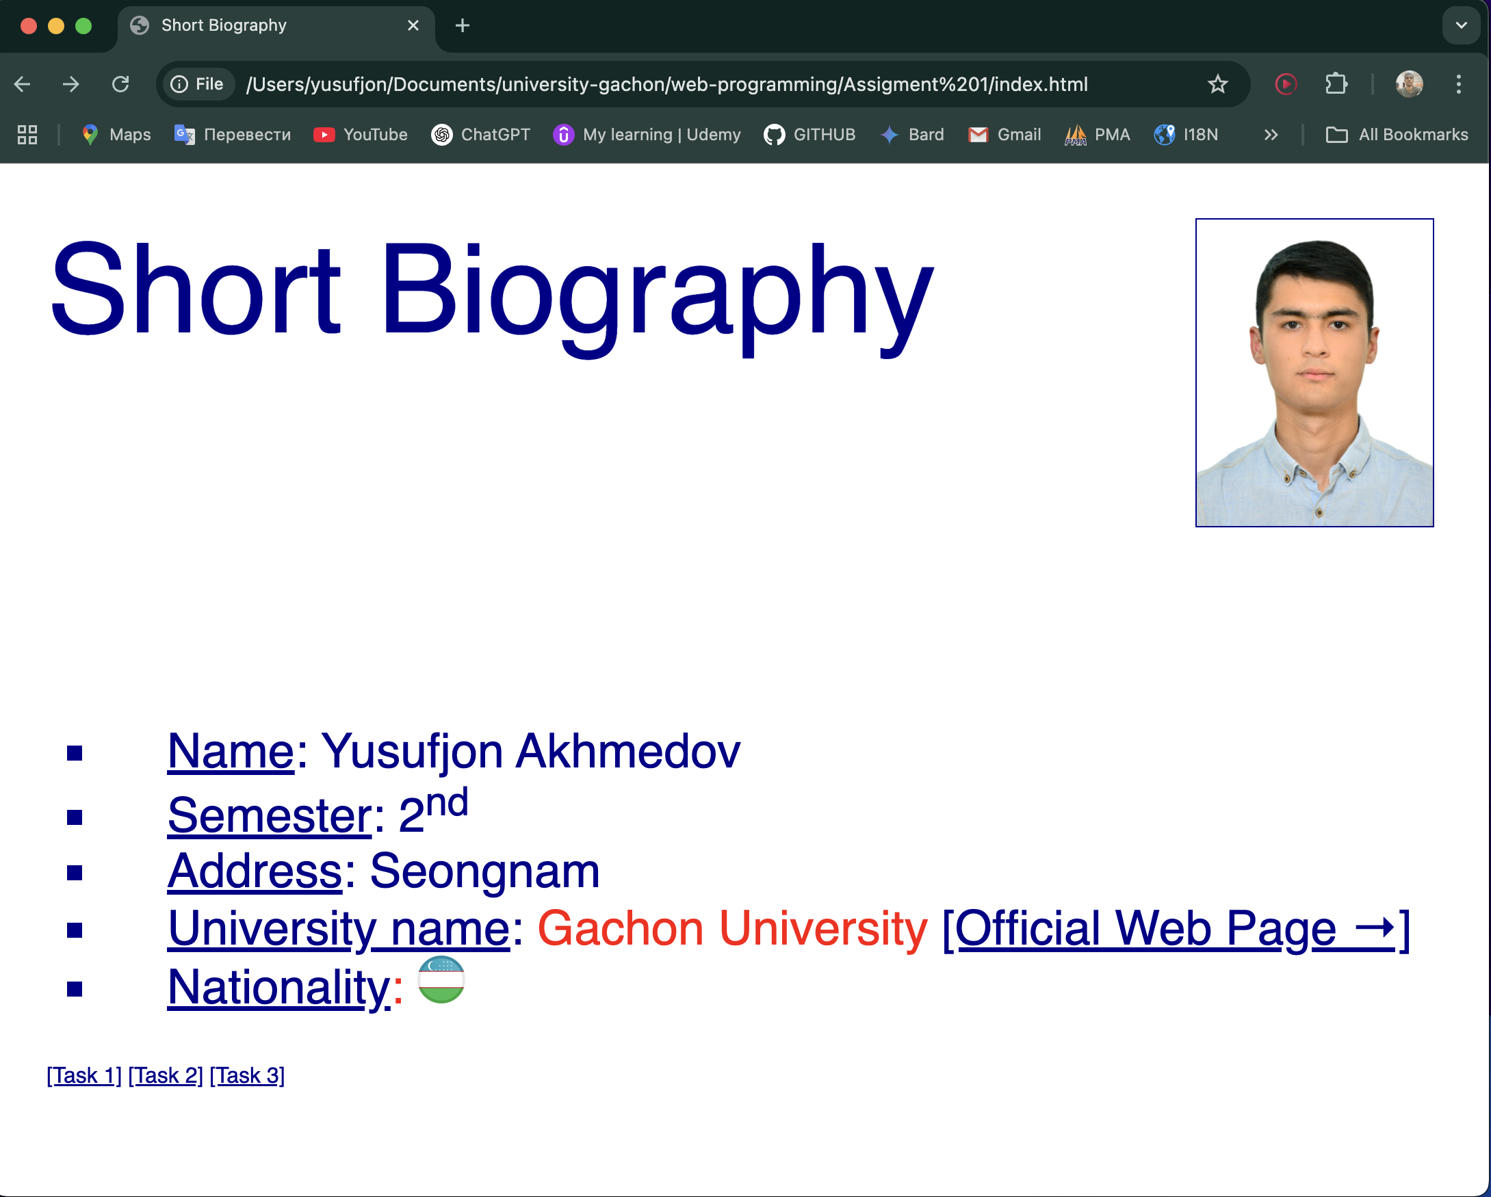
TASK 1 RESULT

Slide 5

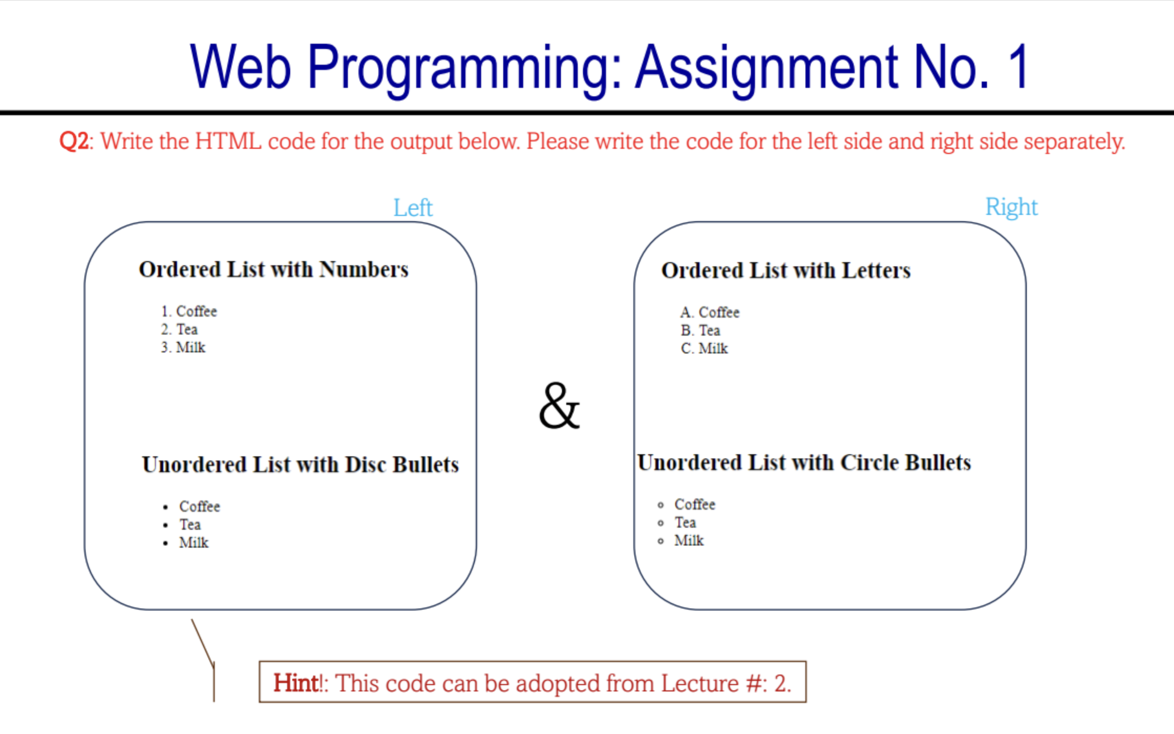
TASK 2:

Slide 6
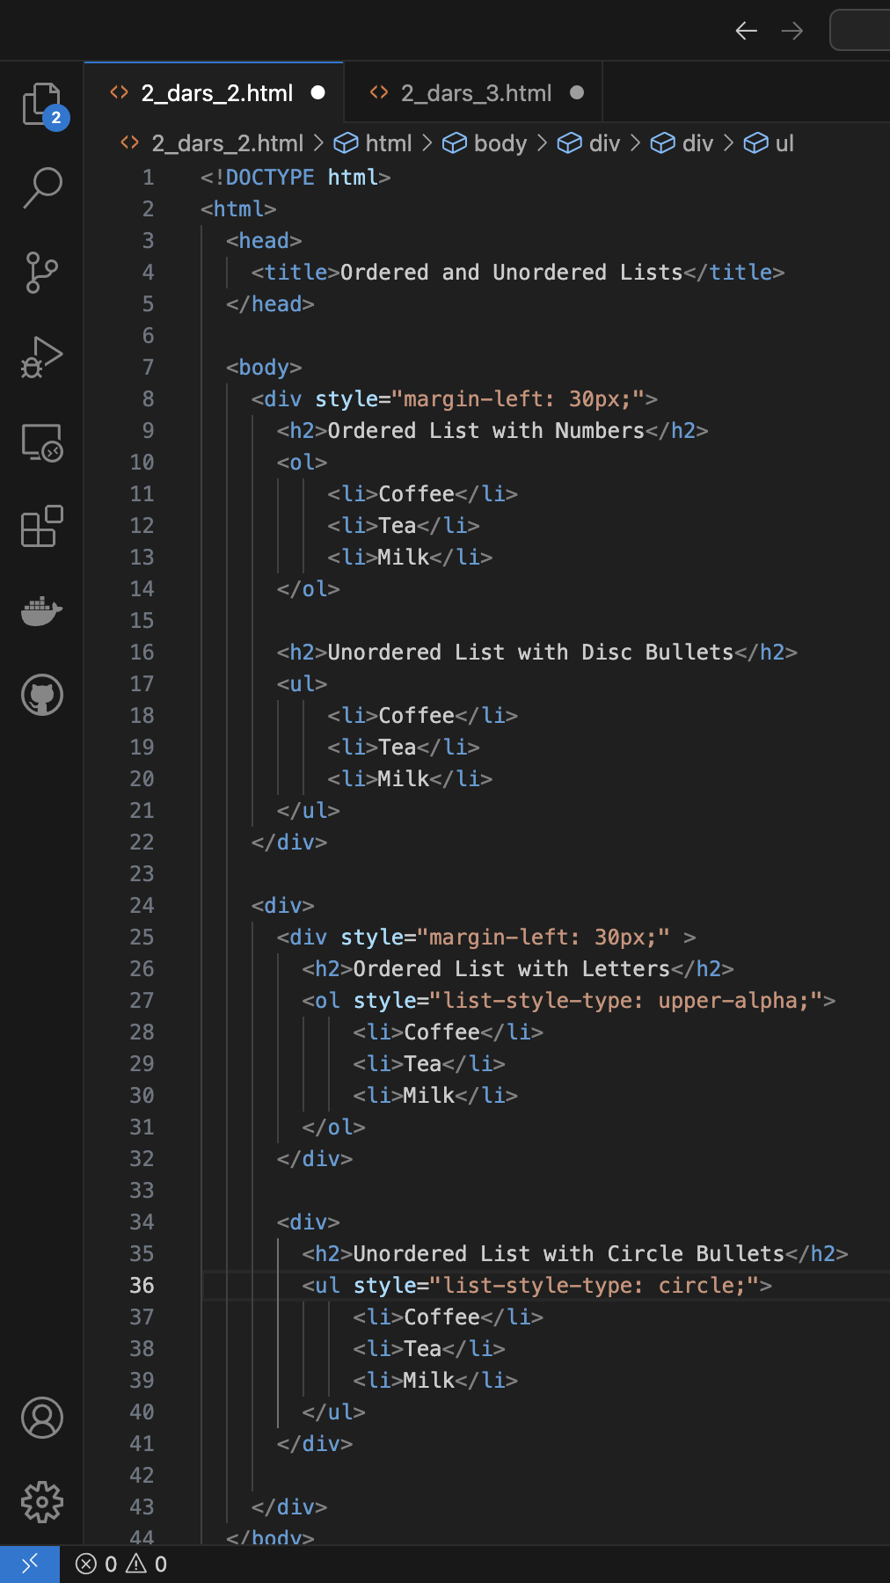
Code:

Slide 7
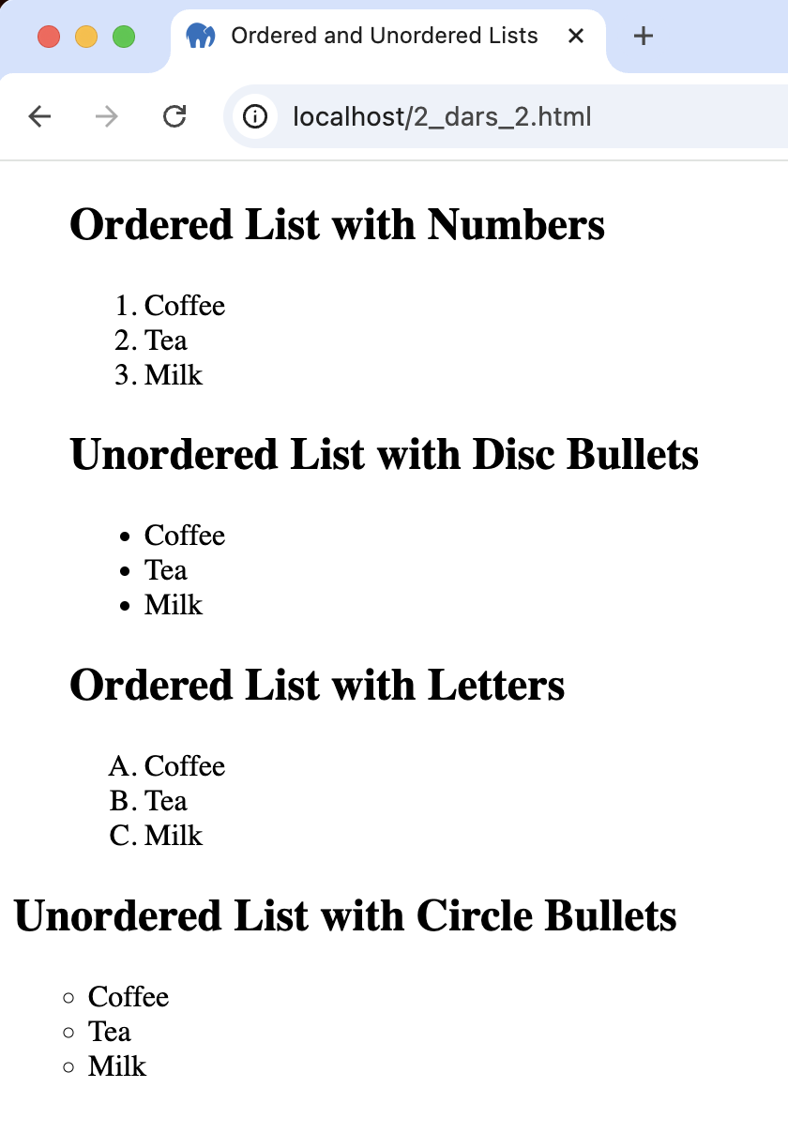
Result

Slide 8
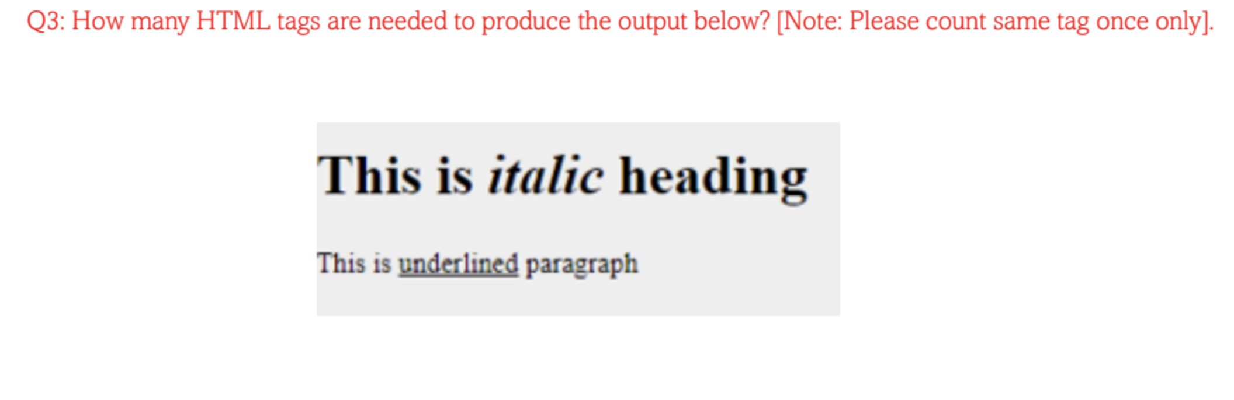
TASK 3:

Slide 9
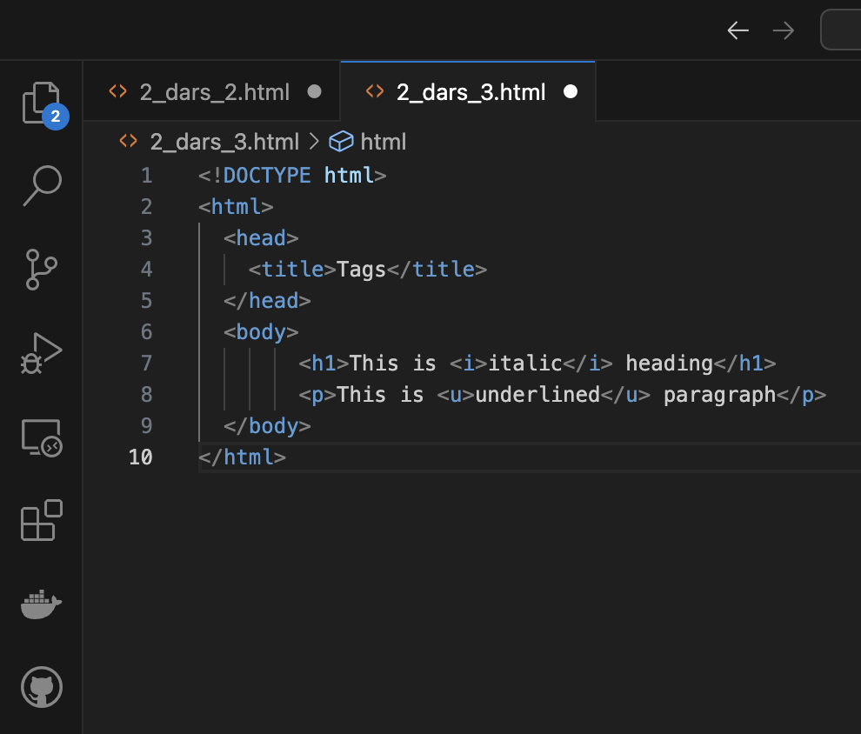
Code:

Slide 10
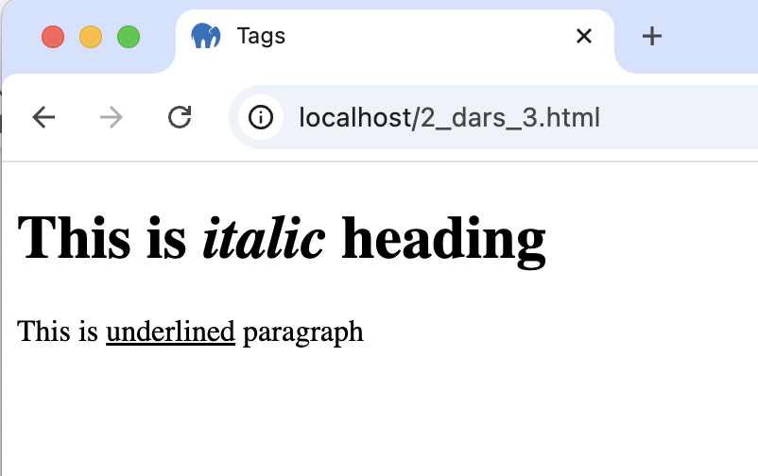
Result
d
It depends. The minimum amount is 4!

Slide 11
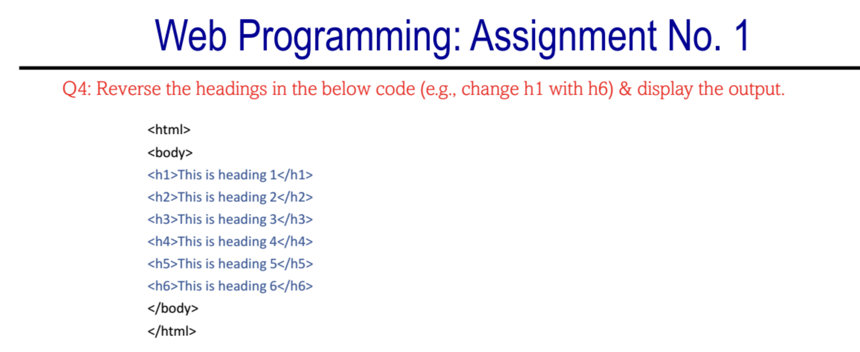
TASK 4:

Slide 12
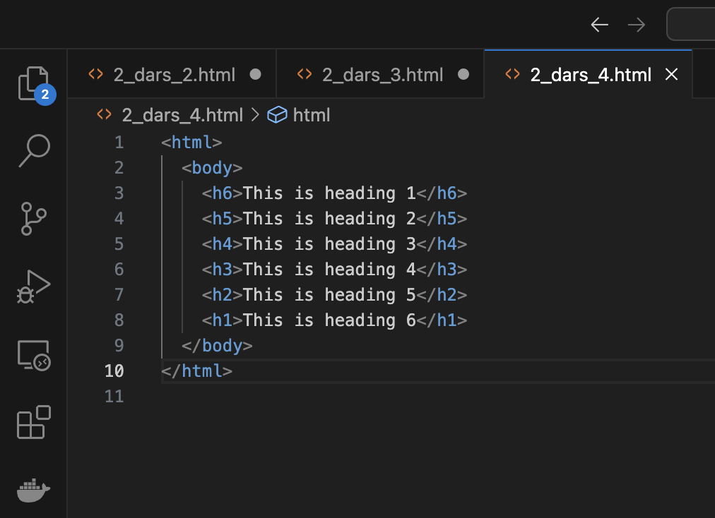
Code:

Slide 13
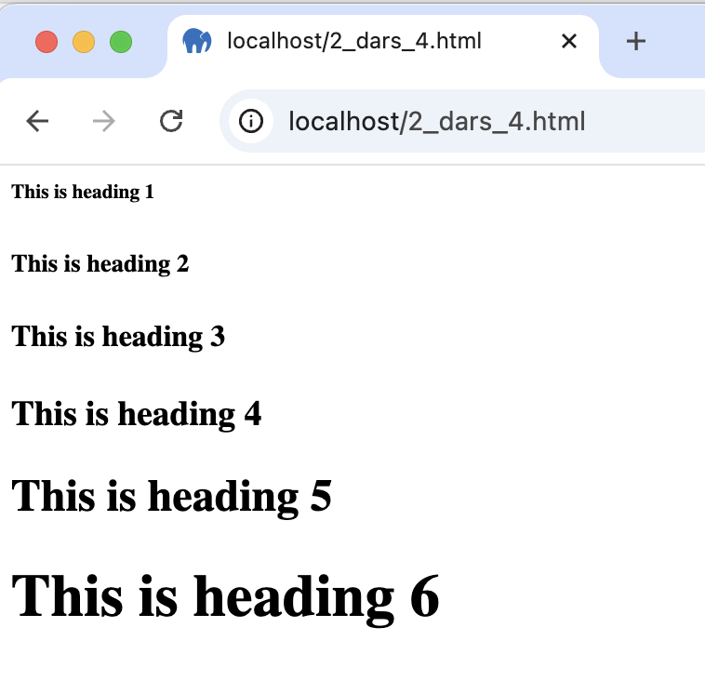
Result
d

Slide 14
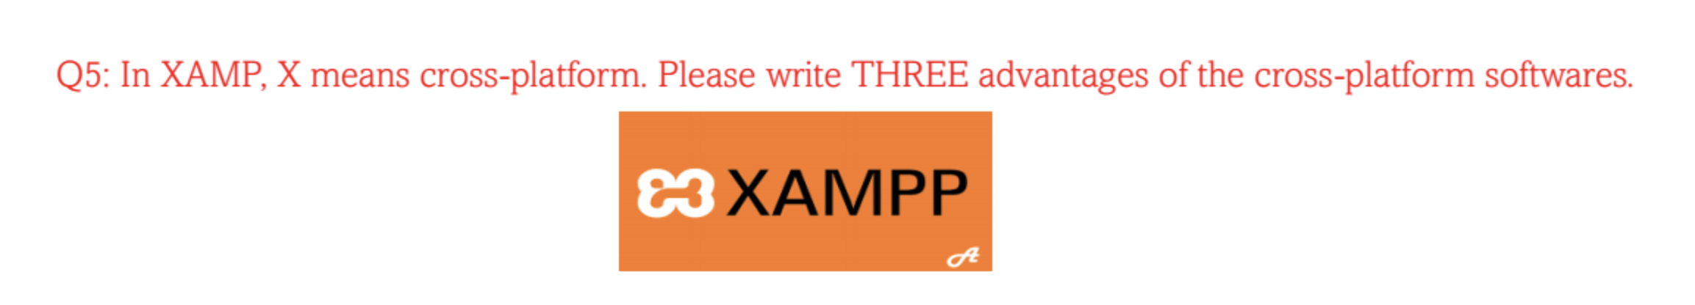
Question 5:
1. Saves Money: Instead of making separate versions for each platform like Windows, macOS, or mobile, developers can write the code once and use it everywhere. This reduses the time and money spent.
2. Reaches More People: Cross-platform software works on different devices and operating systems, meaning more people can use it, no matter what device they have.
3. Easier to Update: Since there’s only one version of the software, it’s much easier to fix problems or add new features. Developers can make changes once, and it automatically applies to all platforms.

Slide 15
THANK YOU
Akhmedov Yusufjon
ID: 202438404​
yusufjon@gachon.ac.kr​
Muhammadsodiq
ID: 202438404​
yusufjon@gachon.ac.kr​

